Slide 1
Presentation_video :https://drive.google.com/file/d/16fNE6M4alQIeRza7LSwQiET74nCjPhKP/view?usp=share_link FAST ACTING RESISTIVE HOT PLATE WITH CONTROL AND DISPLAY
Team No 21
NIPUN GOYAL (2021102029) AYUSH RAGHUVANSHI (2021102037)

Slide 2
MOTIVATION
Benefits:
Fast heating, precise temperature control
Real-time temperature feedback and energy-efficient
Increased productivity and cost-effective
Applications
Laboratory work, cooking, industrial processes
Investment:
Valuable tool for efficiency and productivity
Essential for achieving goals quickly and reliably.

Slide 3
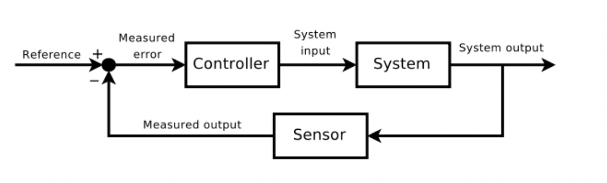
LITERATURE SURVEY
we considered to implement a feed- back loop analog control system. Such system will consist of a temperature sensor, power supply and a method to compare the sensor reading with the expecting temperature and control the power input according to the feedback (sensor reading).

Slide 4
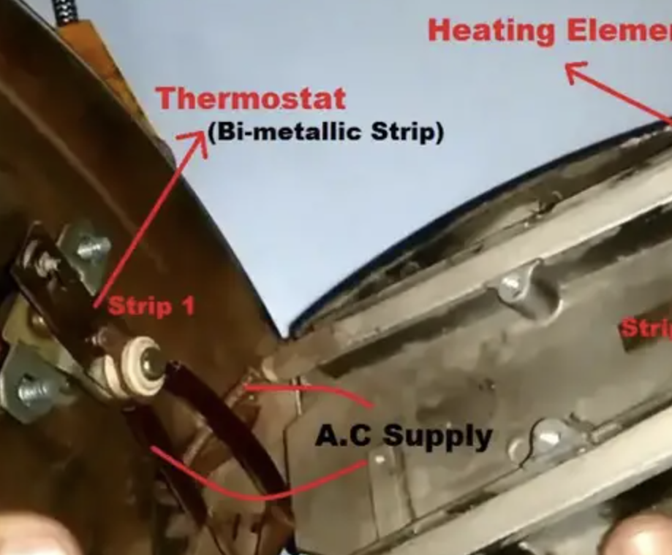
ELECTRIC IRON (INSPIRATION)
We observed that inside electric iron there is a thermostat which bends on increasing temperature, when iron surpasses a certain desired temperature, the thermostat bends and breaks the circuit.
This method is good if we want to implement control over few discrete temperatures.

Slide 5
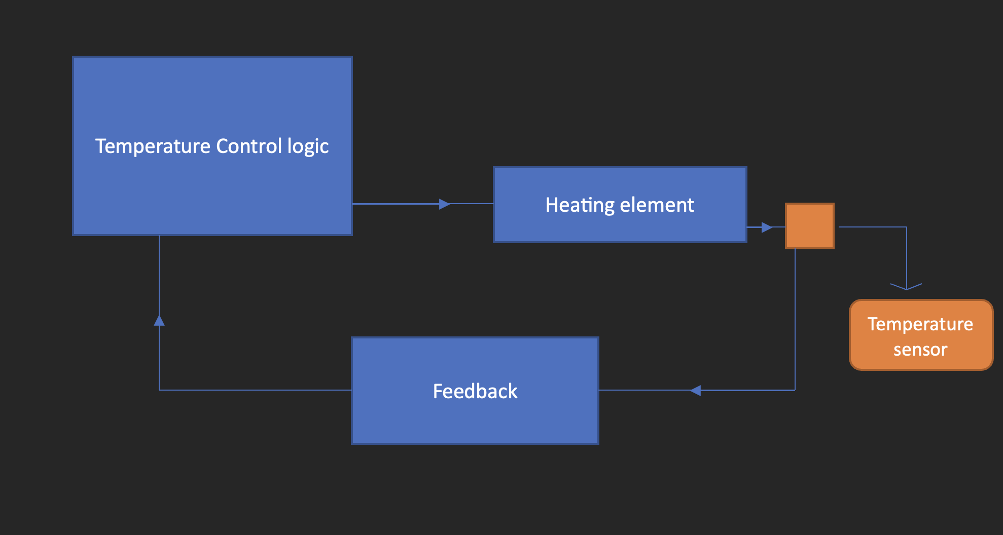
BLOCK DIAGRAM

Slide 6
PRELIMINERY DESIGN
MATERIAL REQUIRED
1 LM35 (temperature sensor)
2 heating element (resistive plate)
3 Arduino and Oled display
4 potentiometer
5 5V comparator
6 NMOS (MOSFET)
7 Diode
8 Relay (DC : 5V AC : 220V)

Slide 7
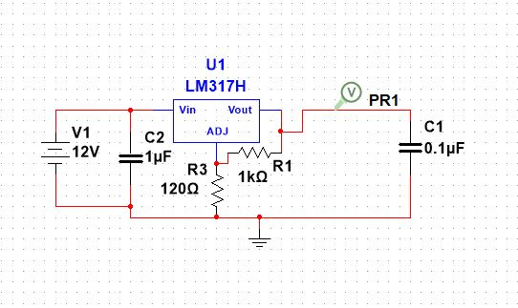
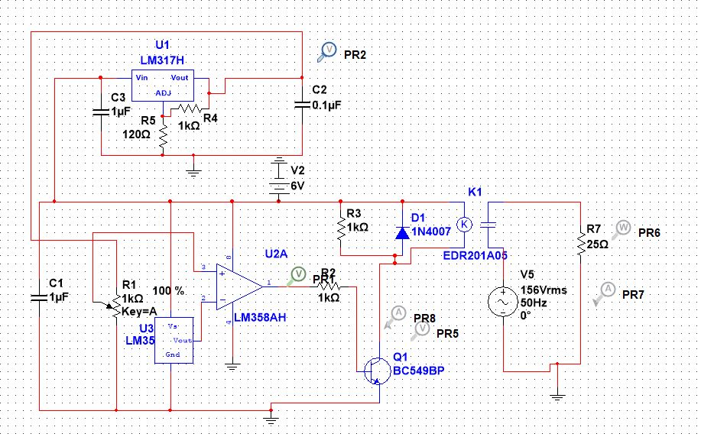
Circuit diagram

Slide 8
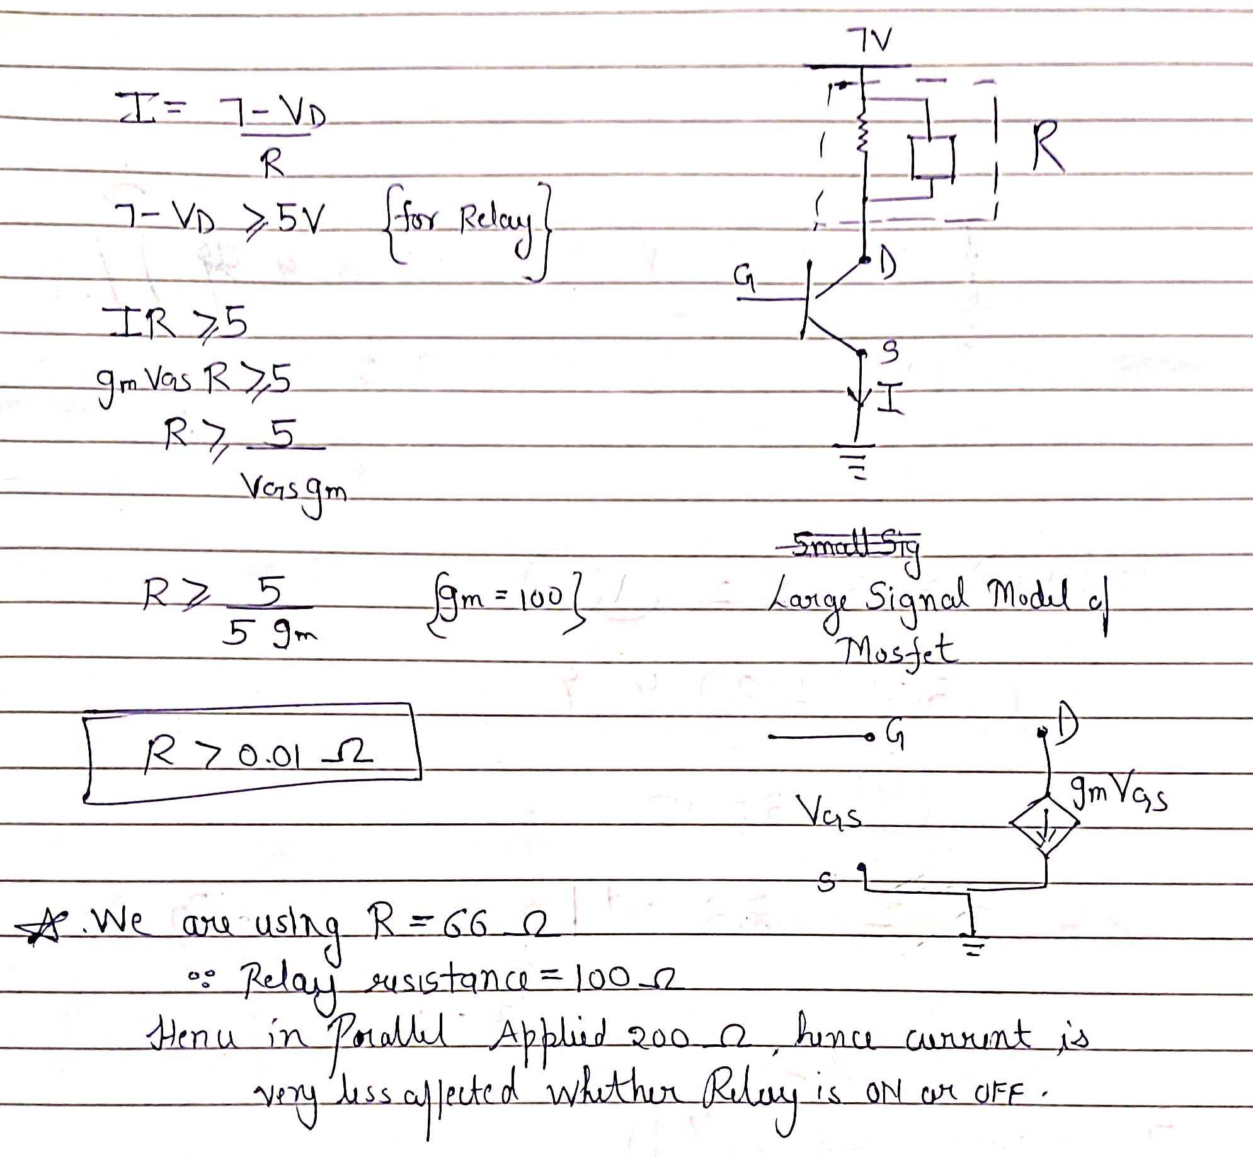

Slide 9
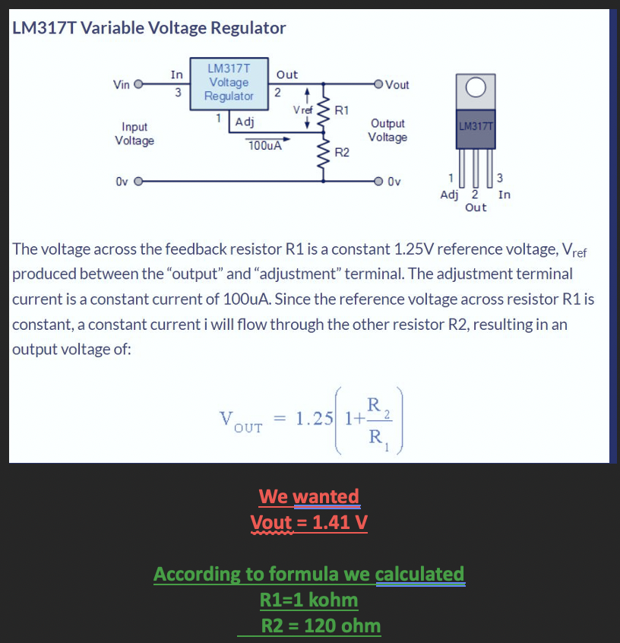

Slide 10
BASIC INTUITION OF WORKING OF CIRCUIT
We are using LM35 as our temperature sensor and it outputs analog voltage = 10*(temperature in degree c) mV.
We set a desired voltage to one terminal of comparator proportional to desired temperature and when present voltage corresponding to present temperature of heating element exceeds the desired voltage then comparator gives 0 V and NMOS turns off and hence relay turns OFF and hence heating stops.
Otherwise NMOS turns ON and 220V AC passes through heting element and it again starts heating.

Slide 11
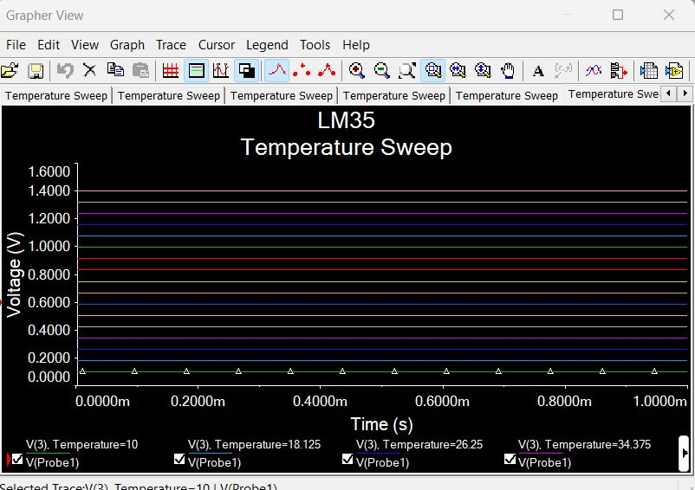
ANALYSIS (LM35 verification)

Slide 12
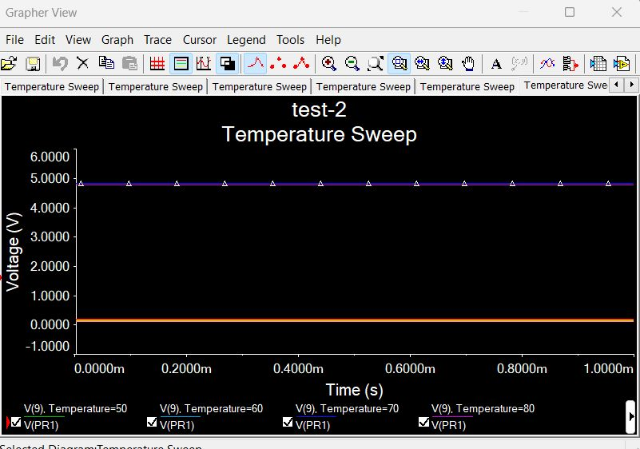
ANALYSIS (comparator outputs at various temperatures)

Slide 13
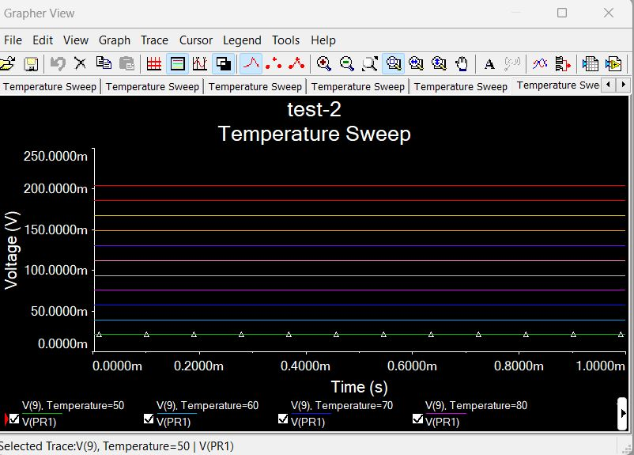
ANALYSIS (Noise)

Slide 14
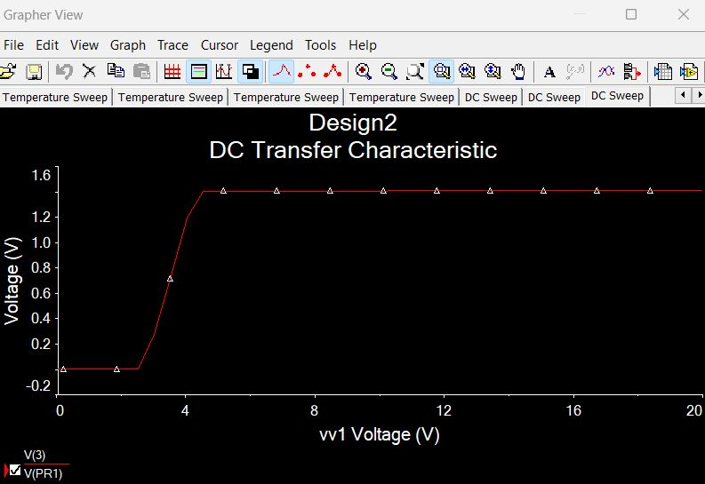
ANALYSIS (LM317)

Slide 15
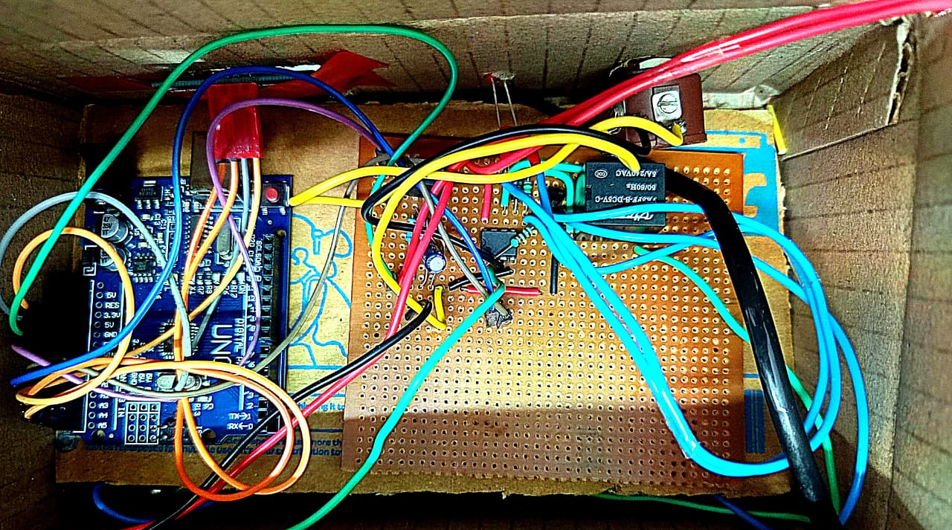
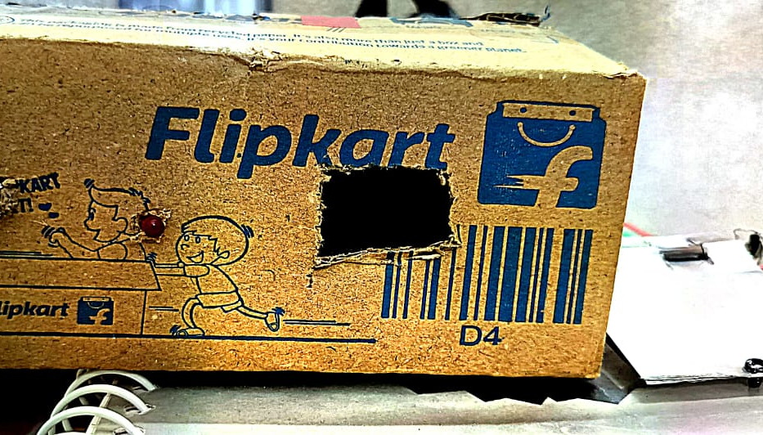

ON BOARD CIRCUIT
We have prepared a proper casing for out control logic with a resistive heating plate projecting outwards.

Slide 16
TEST SUMMARY
We tested our device with 7V DC and 220V AC and we observed that it was working fine .
We set our desired temperature to be 100 degree C and the temperature started to rise and once it reached 100 degree C LED stopped glowing that meant circuit is now OFF after that it cooled and once temp reduced from 100 then it turned ON again.
After that we poured water on it to check whether it boils or not and we observed that it boiled and vapourised.
We can not heat it above 130 due to limitation of LM35.

Slide 17
CHALLENGES FACED
One of the major challenge that we faced was working with 220V ac . It included converting AC to low volt DC which various times got very risky (We burst few capacitors and resistors)
Another challenge was choosing appropriate heating element and resistive plate selection.
Another major challenge was choosing a temperature sensor that has a decent temperature range and also provides linear temp vs voltage curve .
We also found it challenging to attach our temp sensor with heating element .

Slide 18
POSED IMPROVEMENTS AND CONSTRAINTS
One can use a LM35 temp sensor , its V=(10mV)*(temp) is linear But constarints with it is that its temperature is only 150 degree C.
Aluminium can be very decent as an resistive plate due to its satisfactory conductance.
Mica can be used as heating element due to its high resistivity and heat tolerating capacity.
One can use high temperature tape to attach sensor with heating plate , also one can use thread to tie them both or can make a groove in plate and fit the sensor inside that.

Slide 19
CONCLUSIONS
Due to LM35 being slow , we observed a initial shoot up to temperature above the desired temperature which settles gradually at desired temp.
Otherwise the device is working nicely and also displaying and control mechanism are perfect.
It is also fast acting , achieves 100 degree C from 30 degree C in nearly 1 minute.
It is also quite portable device and properly cased as well in a box.

Slide 20
THANK YOU
.

